Slide 1


Managing classes, groups & students

Slide 2
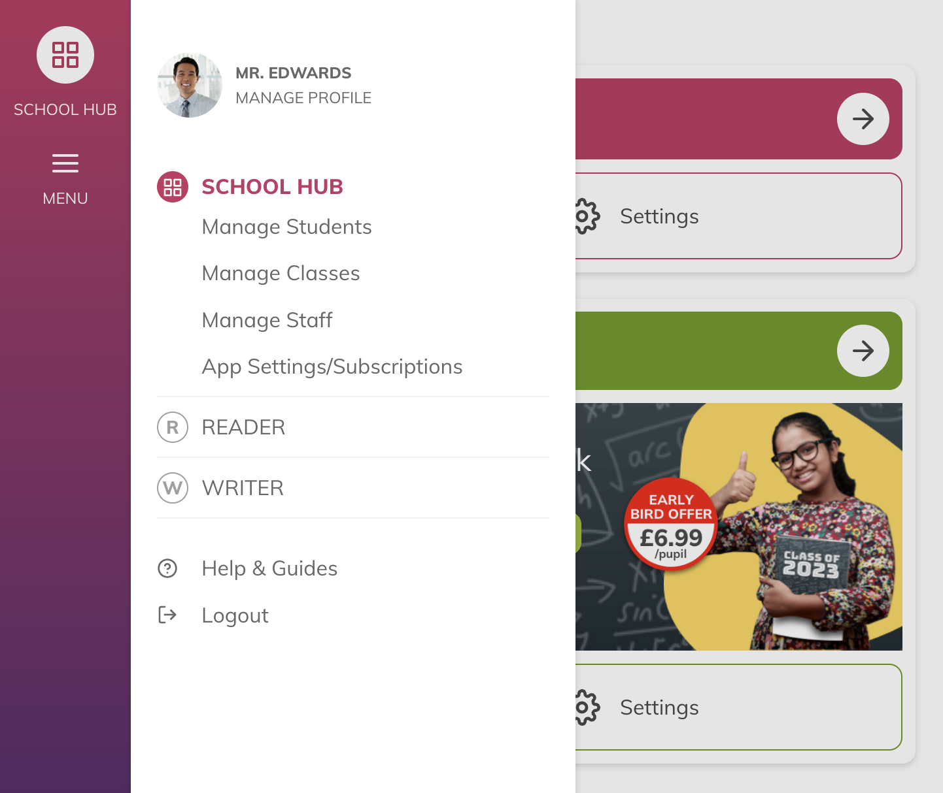

Managing classes, groups and students
Your students, classes and staff listings can all be accessed from the side menu, under the School Hub.
Admins can manage every class.
Teachers and other non-admins can only edit the classes that they have been assigned.

Slide 3
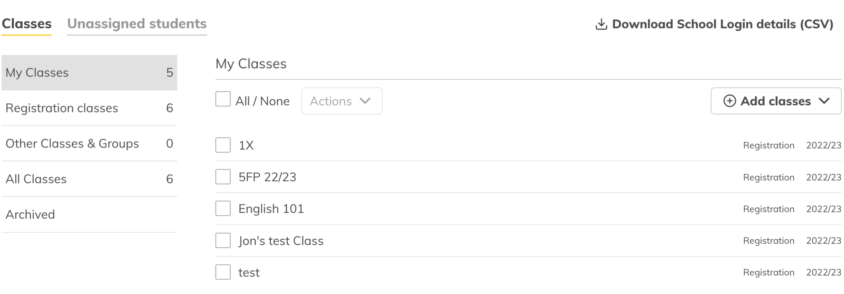
Class Types
We have two types of classes. In the setup of your school you will have created your reg
Registration classes
These usually mirror your registration or form classes. Generally a student is in only a single registration class.
Other classes & groups
These are ideal for target groups, ability groups and group reading bands.
Each group can contain pupils from different year groups.

Slide 4

Creating classes
When creating your account you will have created your registration classes.
If you skipped this step you can also upload a school-level list to quickly create student accounts and registration classes.
You can create classes manually to add in any missed registration classes or to set up your other classes and groups.

Slide 5
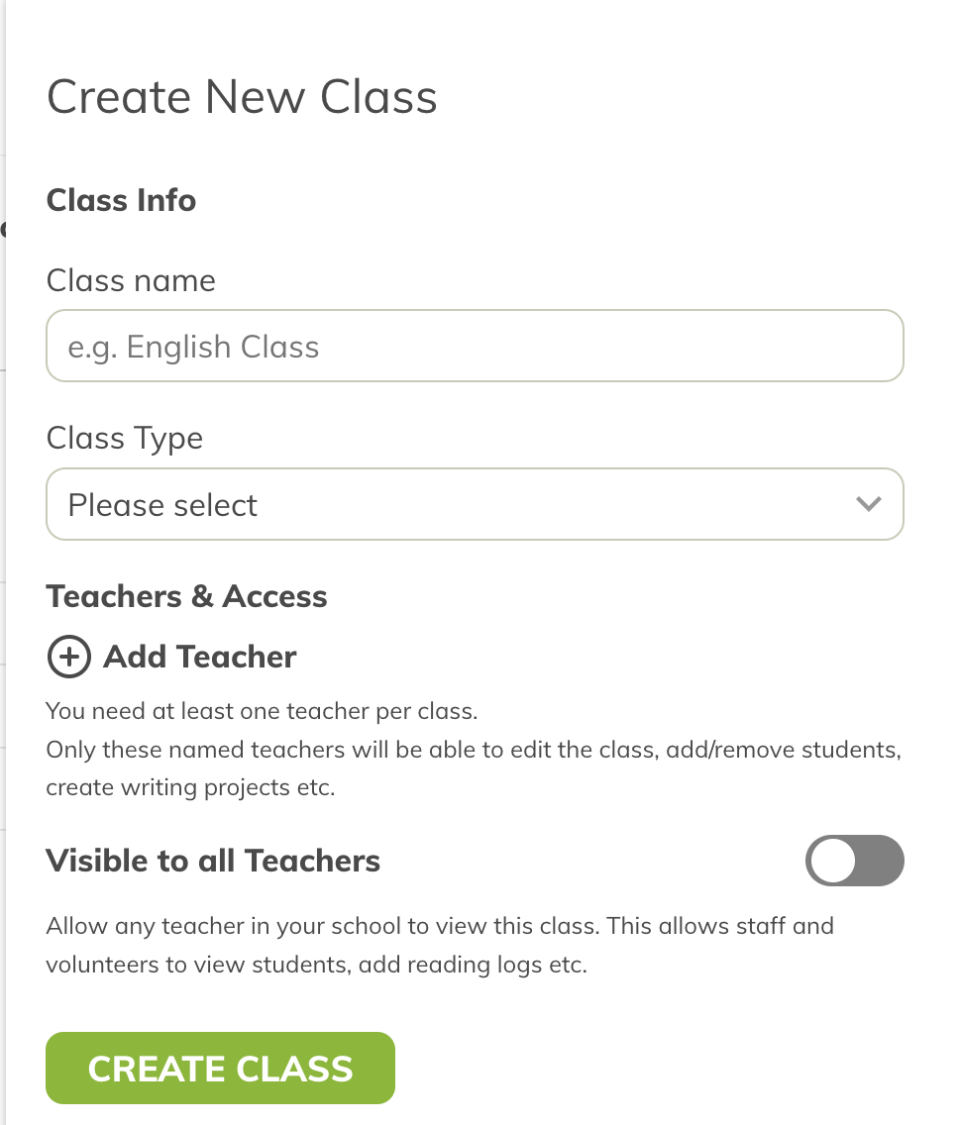
Creating a class
Use the form to create classes, you’ll need the:
Class name
Class type - Registration or Group?
Add the teacher that will manage the class
Decide if this class is visible to all the teachers in the school or those with named access

Slide 6
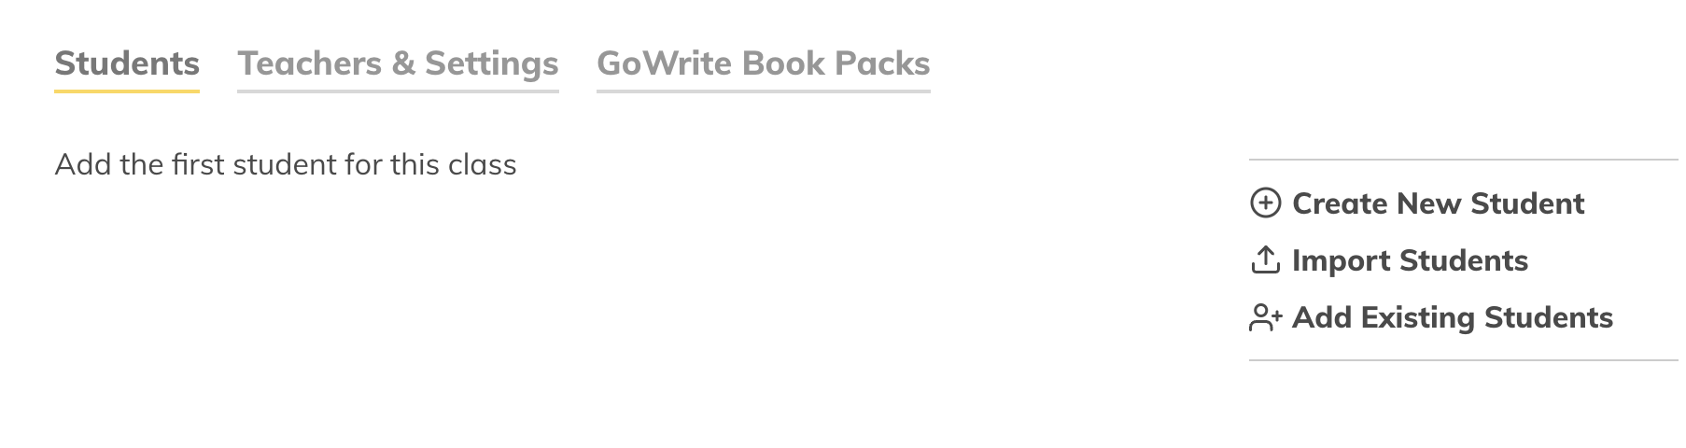
Adding students to a class
If you created a class manually it will not have any students. To add students you can:
Add students that are already in BoomReader
Create new student accounts
Import a spreadsheet of students

Slide 7
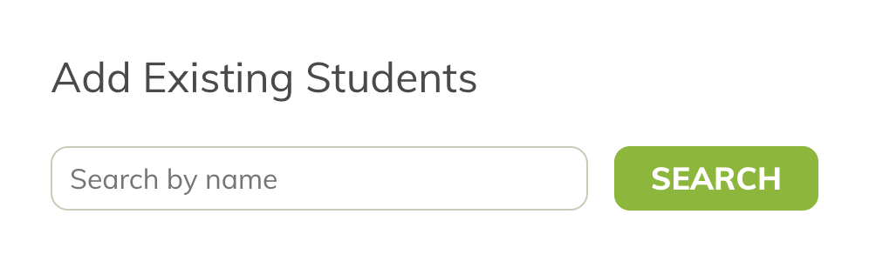
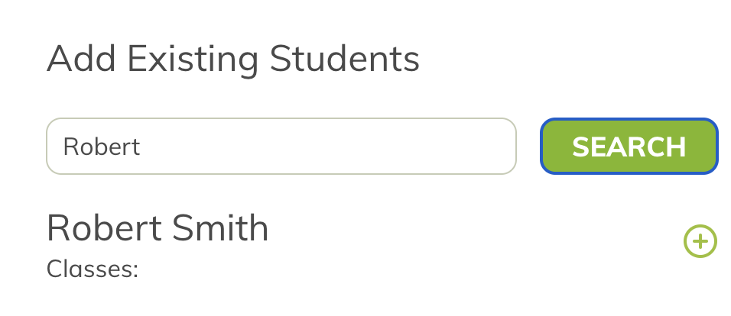
Adding existing students
You can find and add any students simply by searching their name. Type their first or last name to view a list of matches.
Click the add button next to the name to add that student to the class.

Slide 8
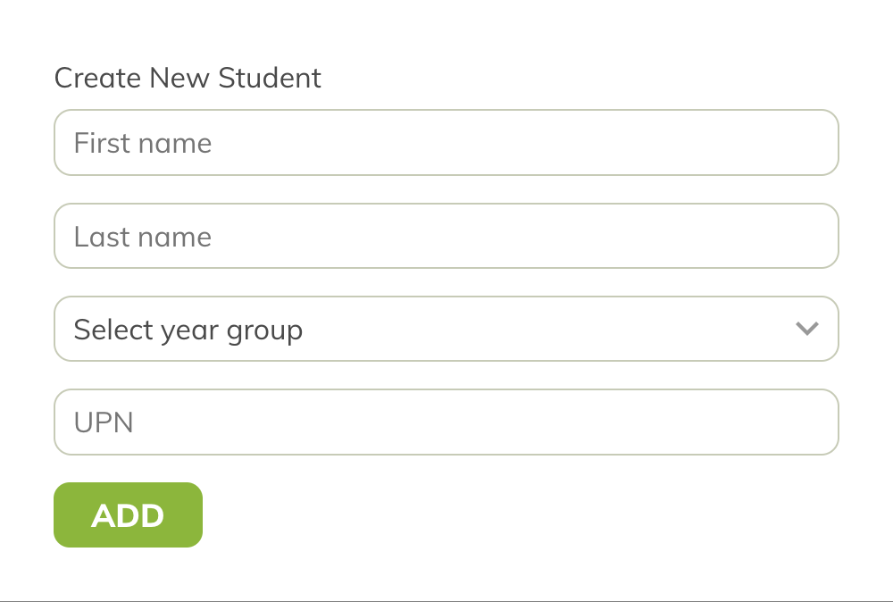
Create a new student account
If you could find the student in the previous steps you can create a new account.
You will need the following:
Their first & last name
Year group
UPN number

Slide 9
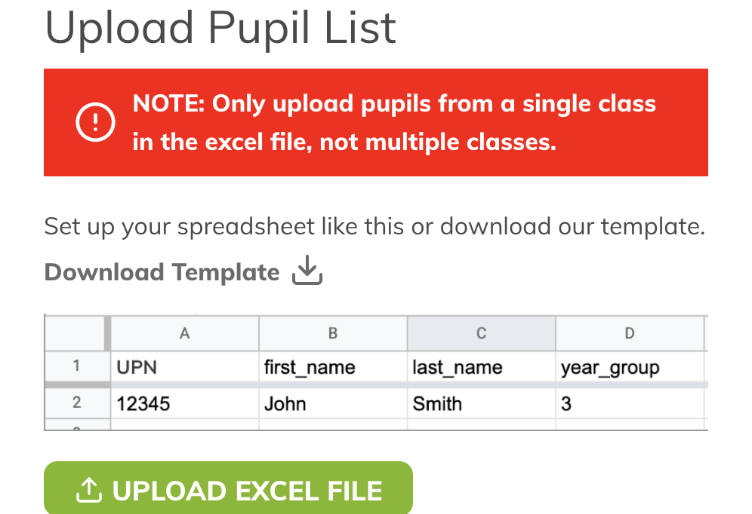
Import spreadsheet
Only do this if you are sure the students do not currently have an account.
To add multiple students, you will need a list of students in a class that you can export from MIS.
Format the spreadsheet as shown. You can download a sample spreadsheet to help you.
If there are any errors in the spreadsheet, you can reformat and reupload.

Slide 10
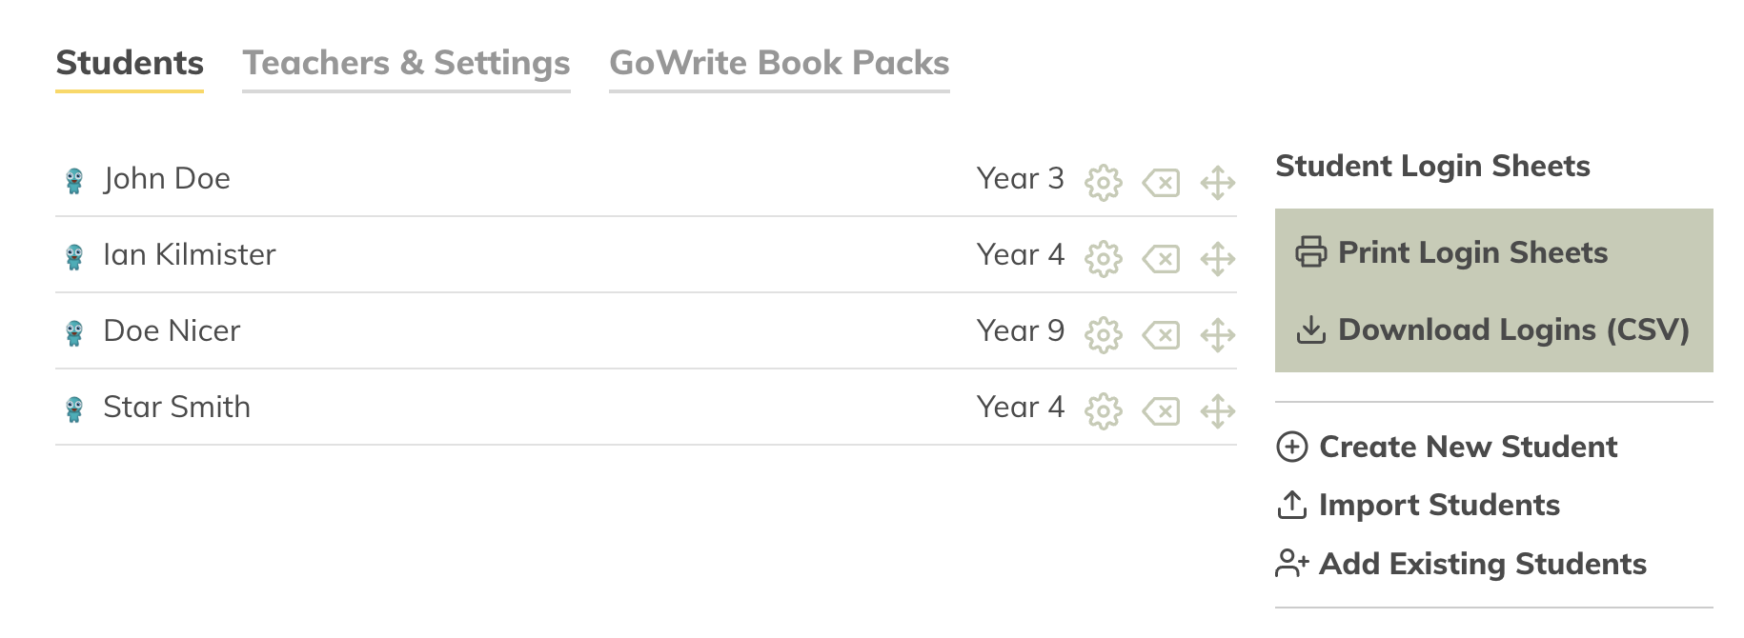
Class administration
Once you have added students to a class, you have the option to edit, delete or move them to another class.
Student login sheets can be downloaded or printed out to hand to students.

Slide 11
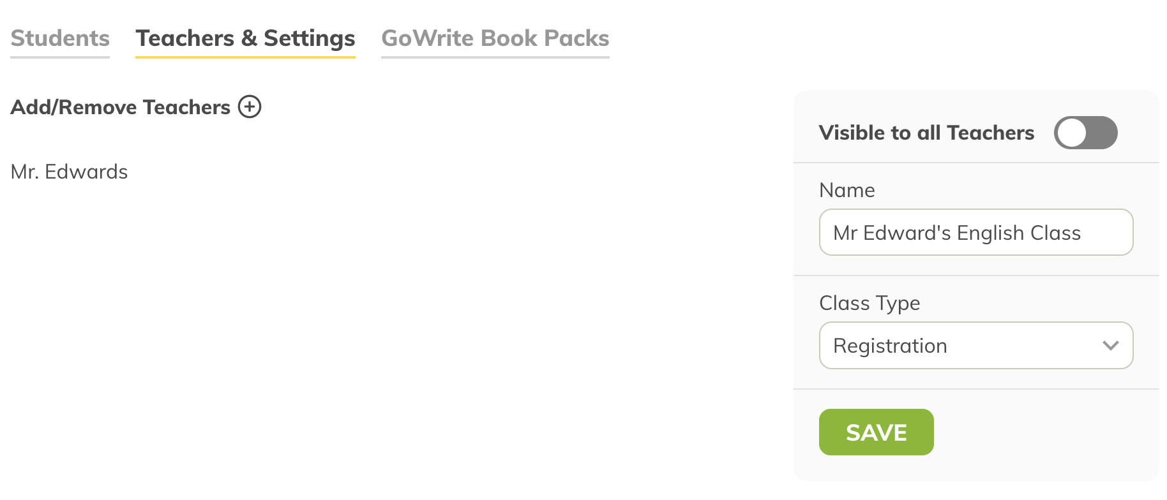
Class administration
On the teacher tab you can see all teachers assigned to the class/group.
You can edit the classes name, type and visibility to other teachers.
We recommend to only add the teachers and assistants that manage the class or group.
All staff can find a students reading log without needing to be assigned to their class!

Slide 12
Visible to all setting
You can also make the class visible to all members of staff.
When on, all your TA’s and volunteers will be able to see the class inside the reading app and update reading logs.
This setting is useful where you would like full transparency or where a high number of staff interact with the class.

Slide 13
Manage Students
As an admin you are also able to see the listing of students in your school.
These are filtered by year group and allow you to quickly find and edit student details.

