Slide 1


Grand Tour:
Week 1
Set Up & Getting Started

Slide 2
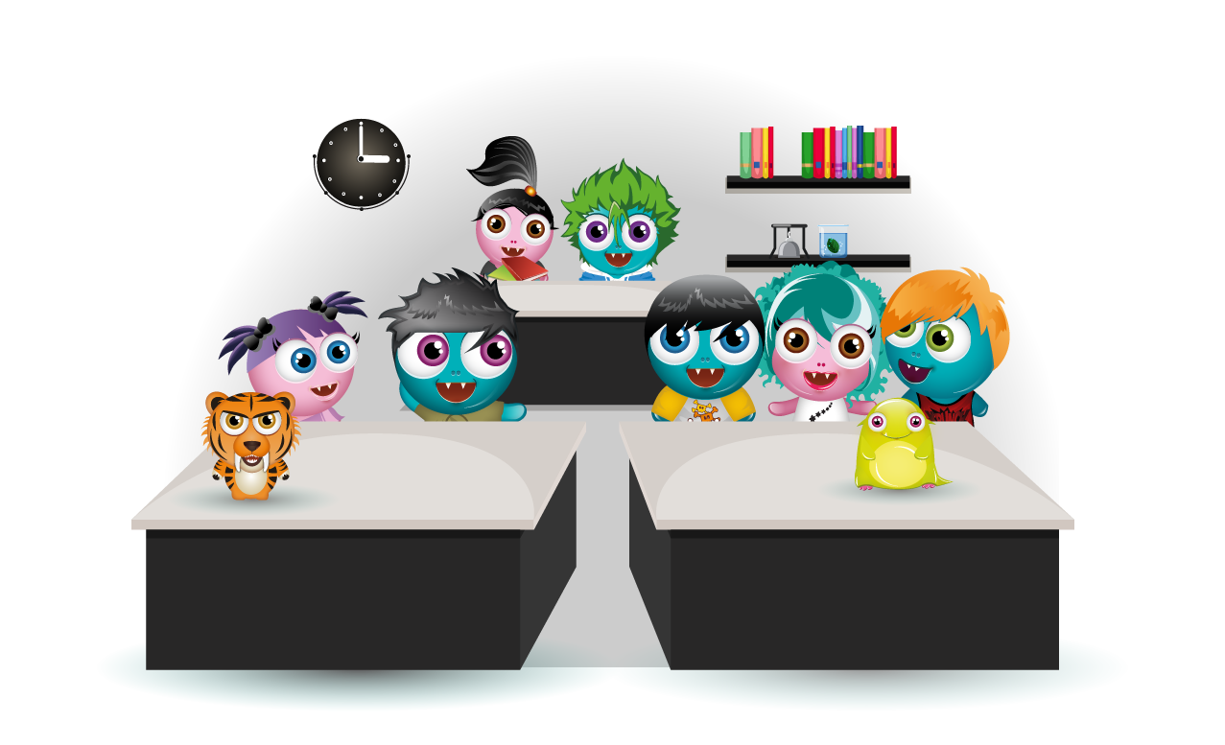

Welcome to the GT
Over the next 4 weeks we’ll guide you through rolling out BoomReader across your school.
Week 1 is all about setting up your schools account and preparing to give staff and pupils training in week 2.
Think about who needs admin access to your school to help you complete this weeks tasks…

Slide 3

Step by step guide - Week 1
Making the change
Before you create your account
  Filtering
  Who needs admin access?
  Prepare student & class list
Create your school account & Start Trial
Setting up Reader
  Reading bands
  Basic settings
  Book Types
  Classes & Groups
Introducing to parents
Coming up in Week 2

Slide 4
Making the change
Swapping to digital diaries like any school wide change can be daunting.
Change management within a school setting is about considering all the key elements of provision along with a clear vision for the future to move people’s thinking and approaches.
In order to create a positive culture for school improvement it is essential for leaders to manage change carefully. The success of any new initiative can often be down to the way that individuals respond to it and how well they are supported by their leaders. The key is to create a positive school culture where teachers are supported in making improvements to teaching and learning and feel empowered to do so.

Slide 5
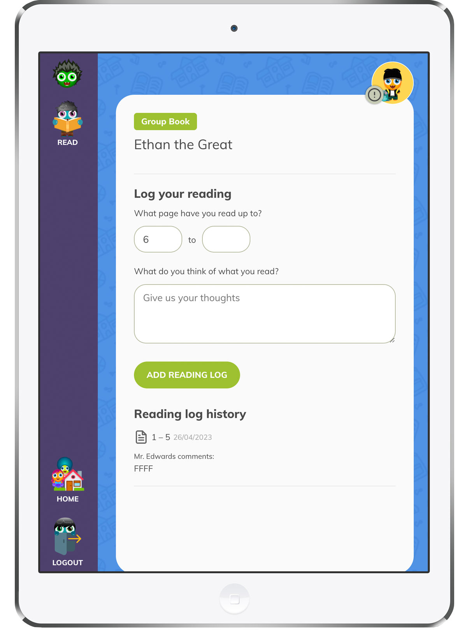
The grand tour is a tried and tested approach to the successful implementation of BoomReader across the whole school.
By following the week-by-week approach you will be making the changes in small steps ensuring strong leadership along the way.
Your goal is to embed a new culture across the community including teachers, parents, pupils and volunteers.
At times this may seem challenging but the advantages of digital reading diaries will be worth it. If you need help or support please contact us and we’ll be happy to help & advise.

Slide 6
Filtering
Before you start using BoomReader please ask your IT/ICT team to add the following to your networks allow-list:
*.boomreader.co.uk
*.boomwriter.co.uk
*.boomhub.app
Emails:
You’ll also need to check you can receive emails from: support@boomhub.app
(Ask your ICT team, add as a contact on Outlook/Email Client)

Slide 7
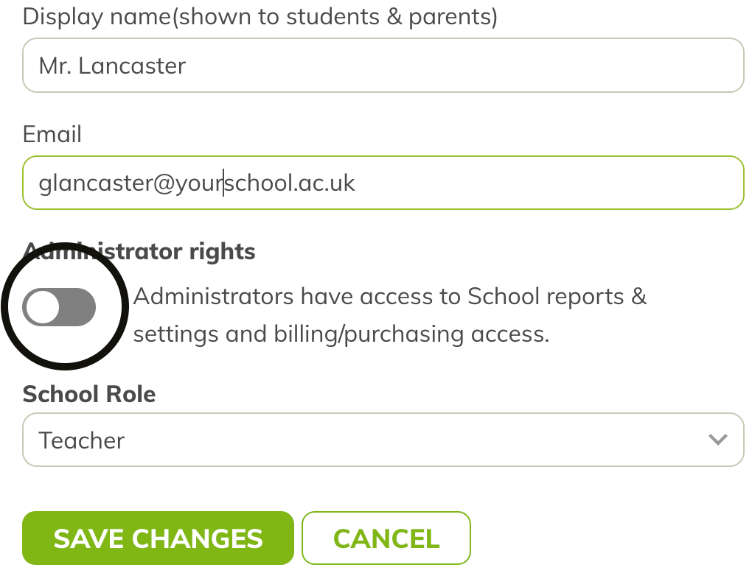
Who needs admin access?
The role of the Admin
Has overall control to manage the product use
Has control of billing and subscription
We recommend having more than one school admin.
Usually the Reading/Literacy lead and a SLT member have admin access.
You may want to give a member of your office staff admin access to be able to assist in setup and administration duties

Slide 8
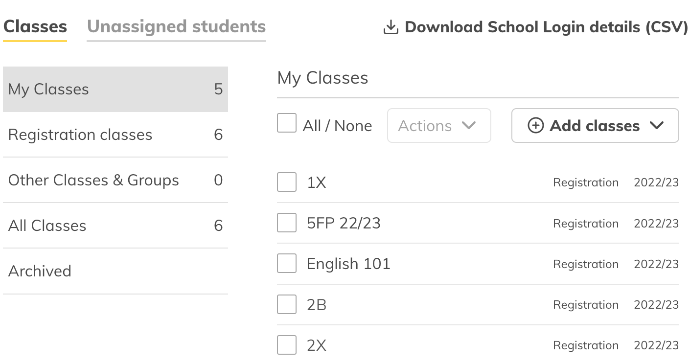
Which Pupils & Classes?
You may decide to complete the Grand Tour with just a couple of year-groups/classes or with the full school.
We recommend that you create all your registration classes and your full student rosta. This will make it easier if you decide to move forward with BoomReader at the end of the Grand Tour.

Slide 9
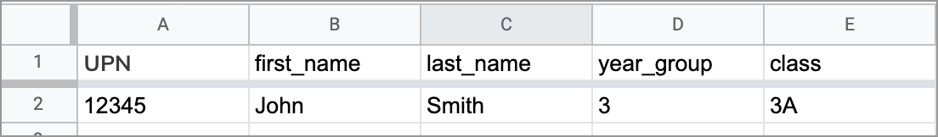
Download Student & Class List From MIS:
You’ll need a Excel spreadsheet (xlsx file) exporting from your MIS system.
The export must be formatted in a specific way for our app to understand it - most MIS systems can export in the format we need however you may need to do a little manual adjustment to get the correct column names/headers or to remove extra columns.
Your spreadsheet should include only the registration classes
Your spreadsheet needs the following columns:
UPN: The students UPN number
first_name: The first name(s) of the student
last_name: The last name(s) of the student
Year_group: Just the number e.g. ‘3’ for Year 3. For Nursery or Reception use ‘N’ or ‘R’ respectively
class: The name of the registration class the student is in

Slide 10
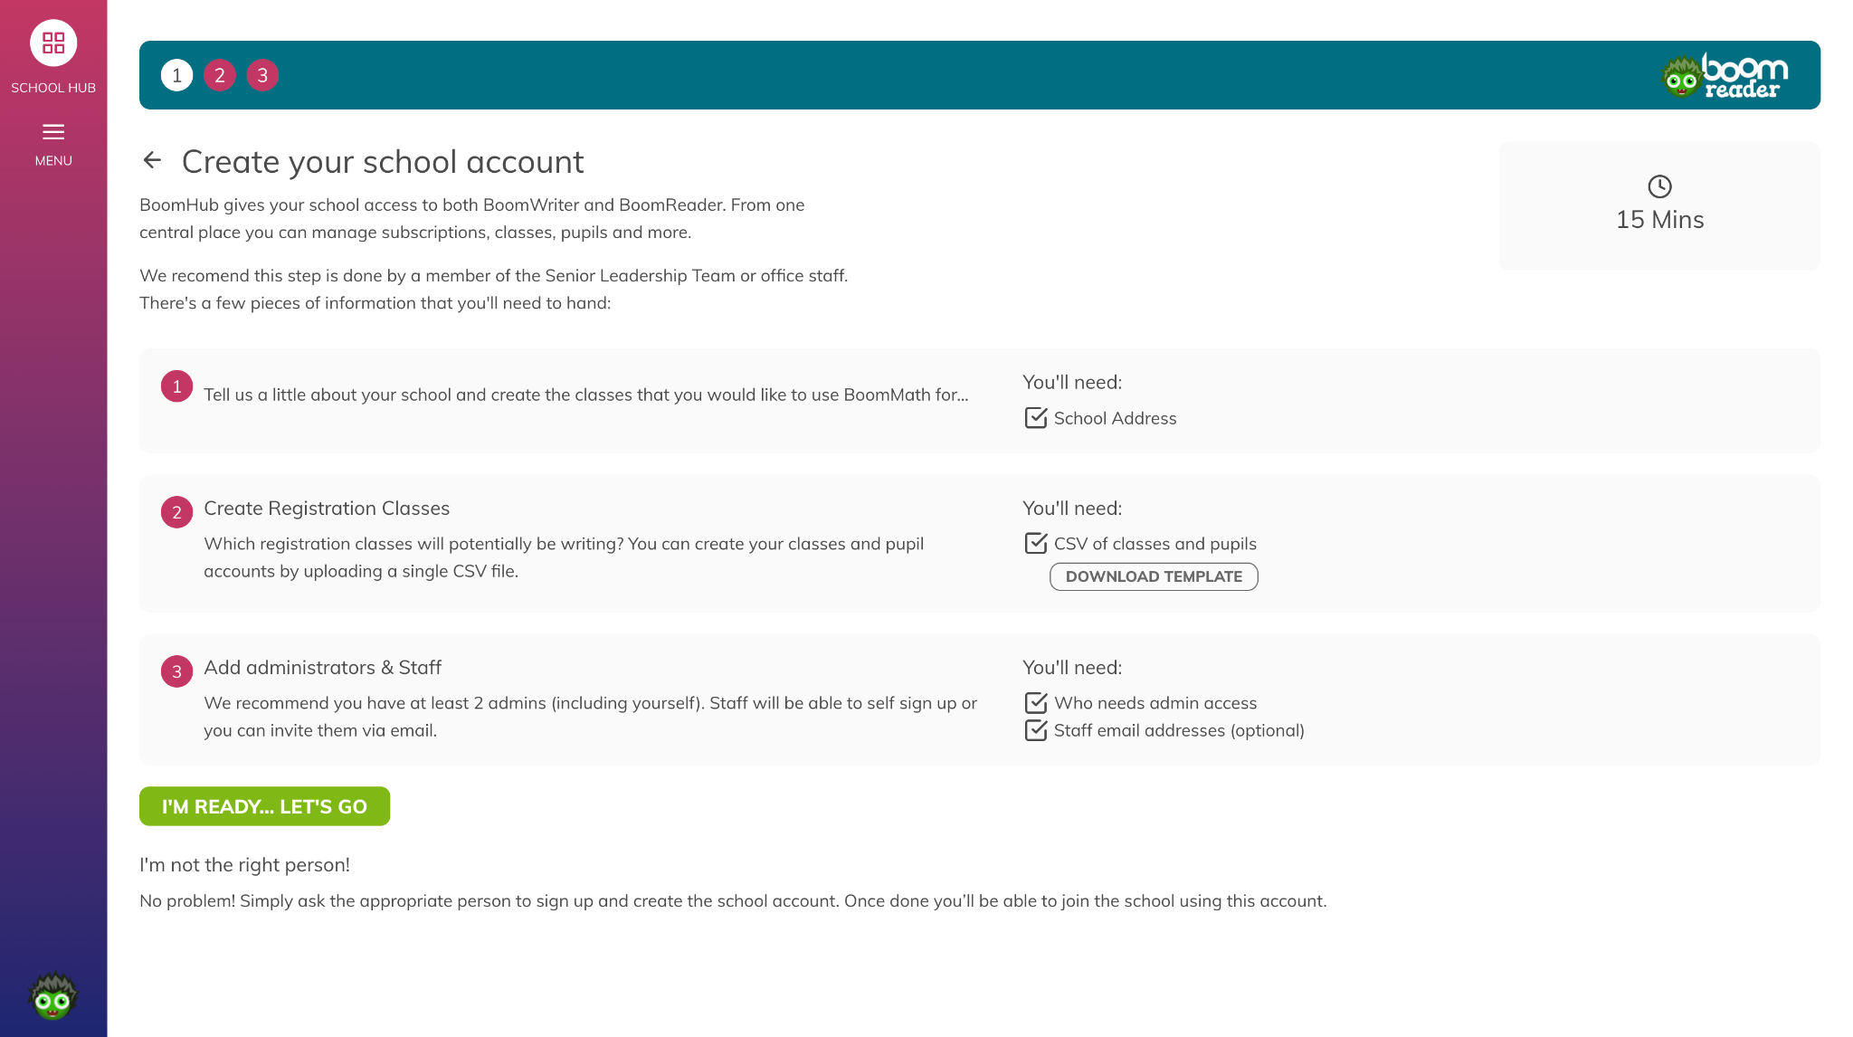
Create your school account
Go to: boomhub.app/signup/read
Create your teacher account (sign-up)
Follow the simple step by step guide to
  Set up your school account
  Upload pupils & classes
  Invite your other Admins
Start your trial
We recommend you only invite your colleagues that need admin access - you’ll invite other staff members in week 2.

Slide 11
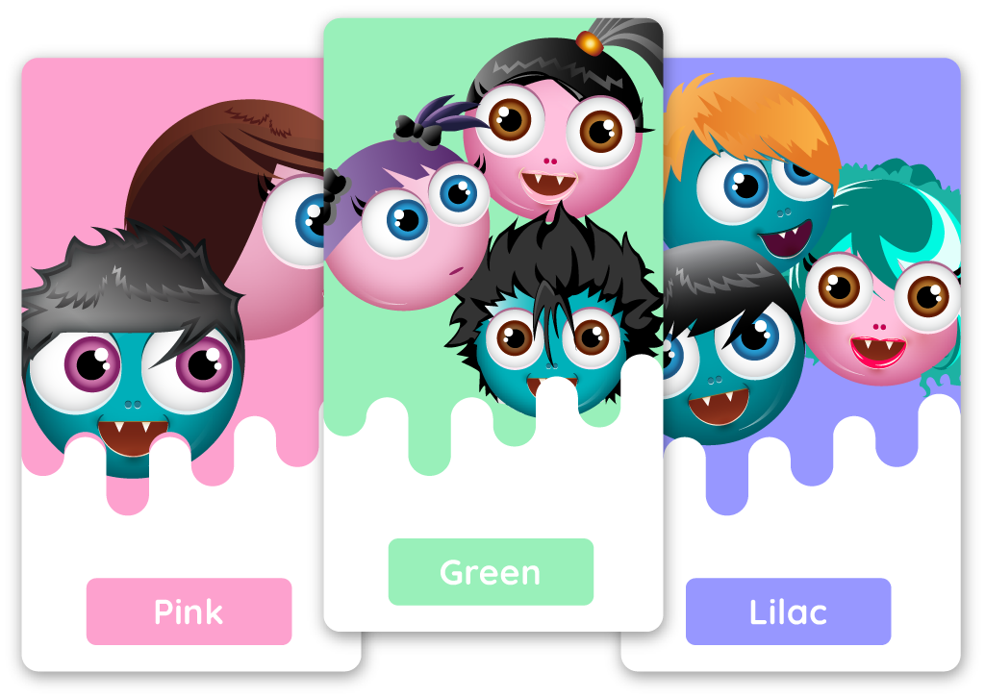
Set up reading bands
Whatever reading band system you use you’ll be able to set these up to track your student progress.
Please refer to our separate guide: Reading Bands

Slide 12
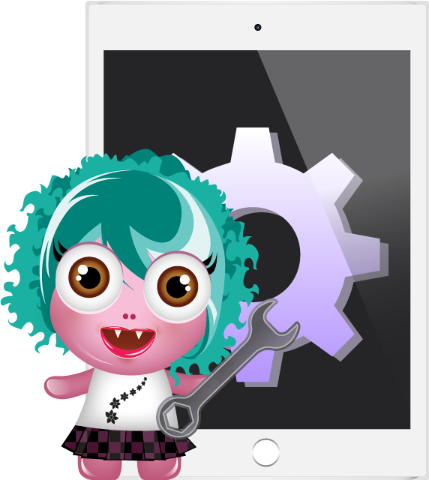
Basic settings
BoomReader has some additional settings that you may want to adjust.
We’ll cover some of the basics and help you decide how to set or use these with your current reading strategies.
Please refer to our separate guide:
Basic Settings

Slide 13

Book types
School book
A book owned by the school. Usually a reading scheme book, or the book the child is issued by the teacher.
Library book
Some schools use this to cover free-reading choices or books checked out from the school or class library.
Home book
A book that belongs to the pupil or their family. If parents and students are encouraged to log these it can give valuable insight into the reading habits outside of the educational environment.
Group Book
These are books read by the whole class or group. They are automatically tagged. You’ll learn more about Group Books in week 2.
When you add a book to a student you can choose from one of three ‘types’. These have been designed to be flexible to adapt to the different reading systems that schools use.
We recommend setting a some simple guidance so staff, pupils and parent know which to use.

Slide 14

Managing Classes & Groups
Setting up your school you created your registration classes.
You can also set up other groups and classes to help you and your staff work with the same group of students based on ability, needs or other factor.
Please review our in-depth guide into how to manage your classes and groups:
Managing Classes & Students

Slide 15
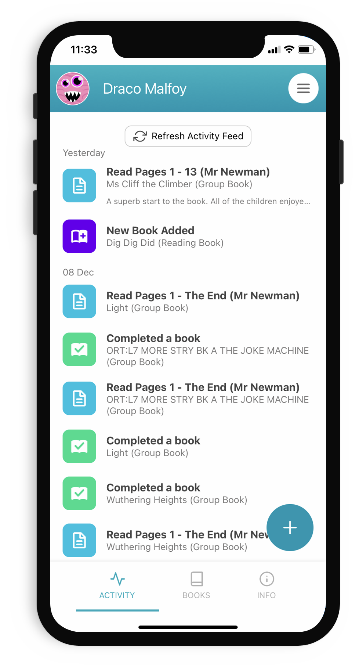
Introduce it to parents
Let your parents & pupils know you are trialing BoomReader, maybe a short article on the school newsletter. This should be to build excitement and positivity.
Parents can continue with their paper diaries for now - in week 3 you’ll ask parents to start using the app.
Consider how you will be presenting to parents in Week 3 - we’ll provide a simple presentation template that you can use (PPT).

Slide 16
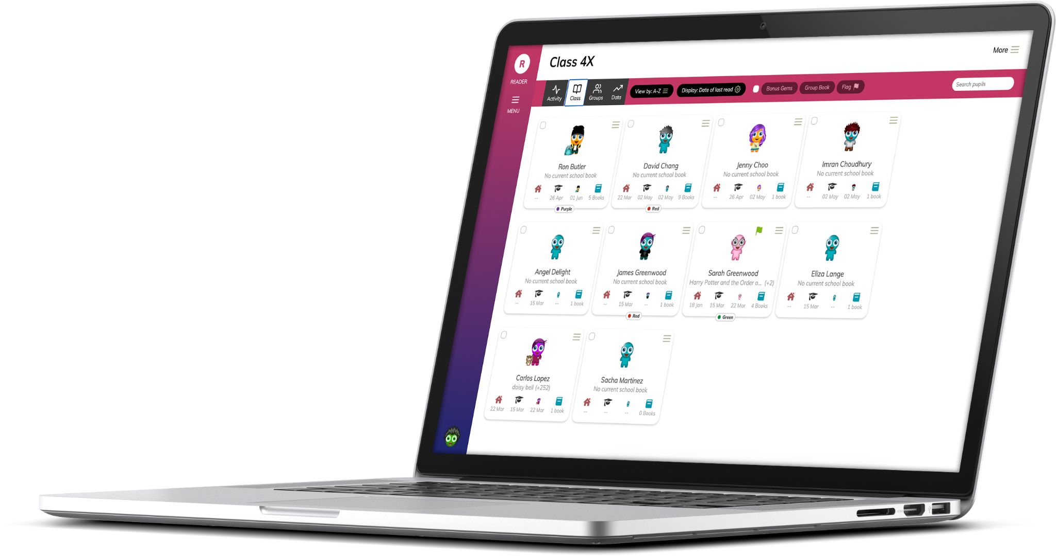
Coming up in Week 2
You, your staff & pupils will review training on how to use BoomReader.
Start using the diaries in classrooms.

Slide 17
Any Questions?
If you need any help or have questions please get in touch:
support@boomhub.app

